Slide 1


Can two interns work in pair & contribute to a CNCF open-source cloud native CI/CD project in only 3 months?
Koumou Jonathan ASSAMAGAN
Mouhamadou KANE
CPS-RES-ESA

Slide 2
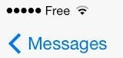
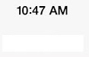
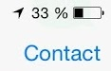
I need to work with some students in Ecole Centrale Lyon
I would like them to work on an Amadeus DevOps topic…
Let them work on open source!
There seems to be this nice project called Keptn…
Let them evaluate it!
It can’t access Splunk and we use it in Amadeus…
Let them contribute to the open source!
The yearly project is over but some things are remaining
Let’s embark two for a summer internship!

Slide 3



Cloud-Native application life-cycle orchestration
Pronounced “captain”
Evaluation and improvements of Open Source Keptn for application life-cycle orchestration
Koumou Jonathan ASSAMAGAN
Mouhamadou KANE

Slide 4
Agenda
What is Keptn?
Objectives
Splunk service & Open-source contribution

Slide 5

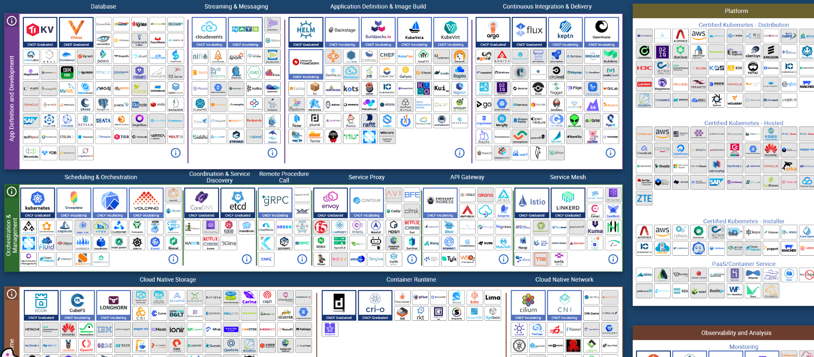
What is keptn?

Slide 6
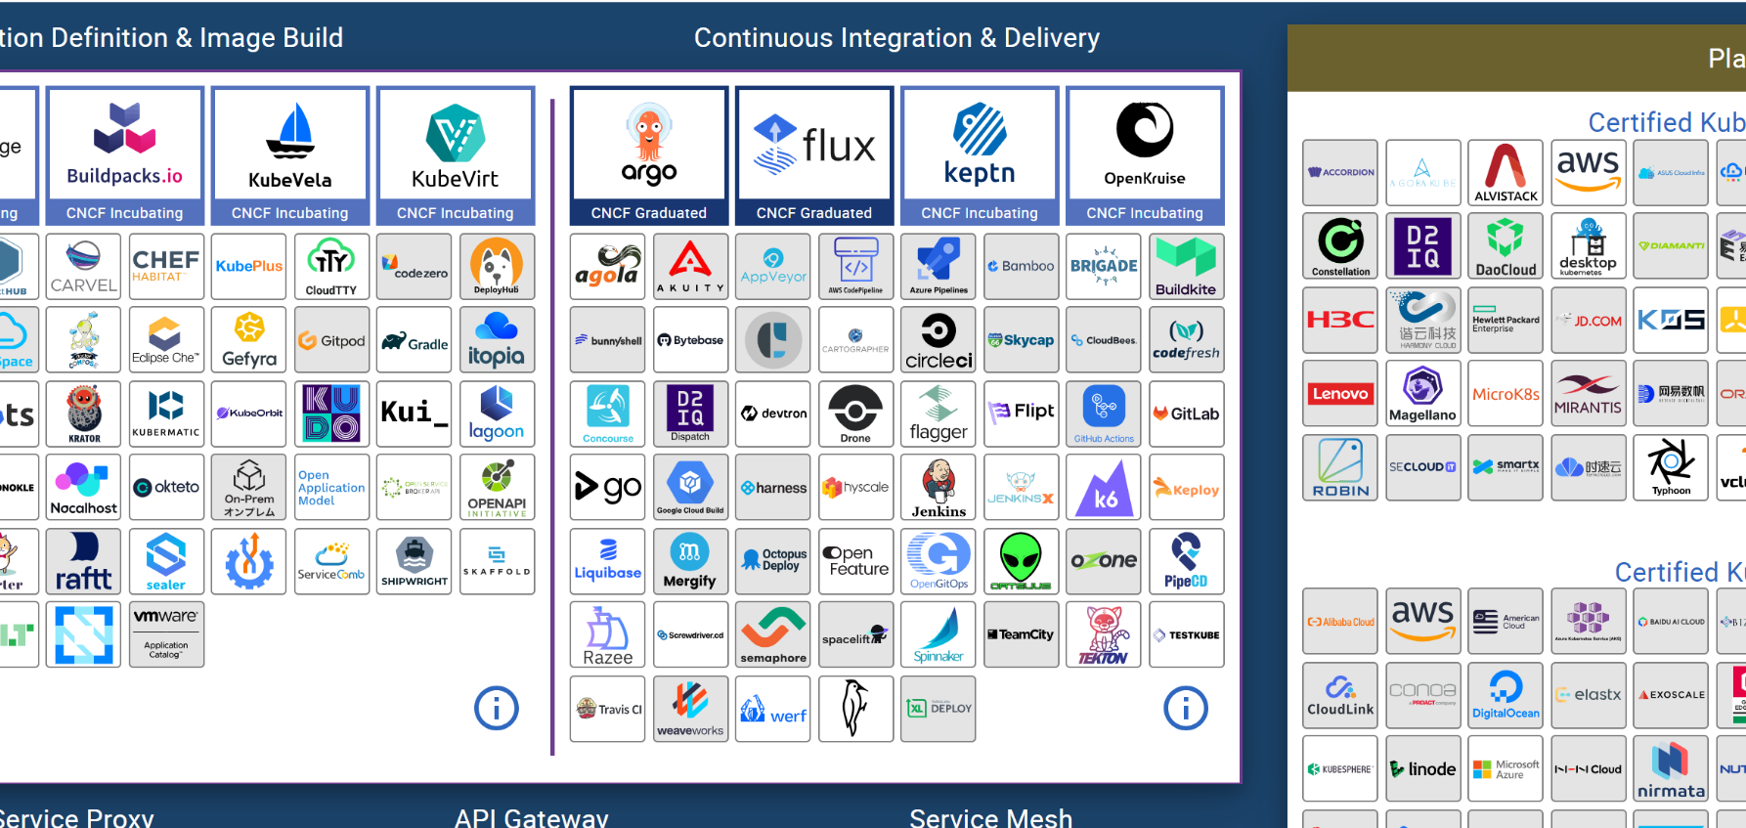
What is keptn?

Slide 7
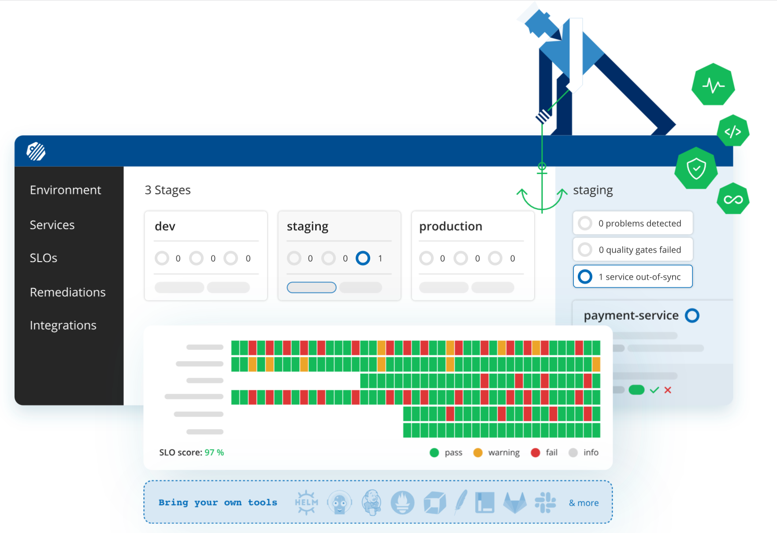

With , you can…
Notes:
An open-source project aimed to automate the life-cycle of an application
Scriptless delivery for maintenance : in a declarative approach
Multi-stage delivery + Quality gates
Multi-step Auto-remediation workflows with built-in evaluation.
Event-based automation
Many integrations (keptn-services, tools) to understand and translate cloudEvents
Keptn runs in a Kubernetes cluster and the workflows are based on git
Separation of concern : Declaration and Execution

Slide 8
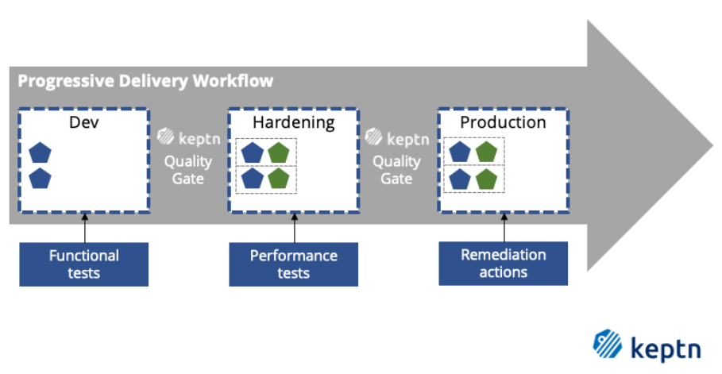
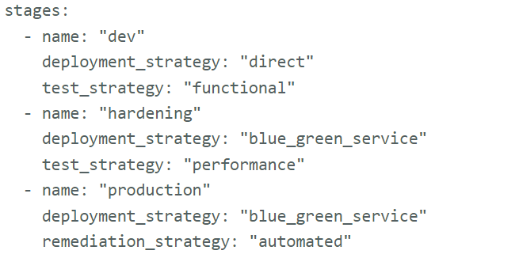
Declarative Multi-Stage Delivery
The shipyard file
Define your delivery pipeline with ease
Without scripting all the details

Slide 9
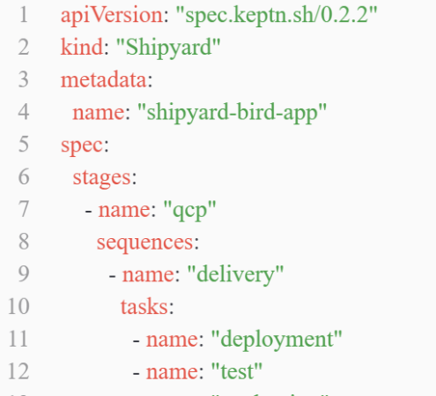
Declarative Multi-Stage Delivery and Event Based
The shipyard file : stage, sequence and task
Triggered by event A
1
Sequence 1
Task 1
2
Sequential
execution
Triggered the event sent by the user
Task 2
Stage 1
3
Task 3
1
Sequence 2
Task 1
Triggered by event B
2
Task 2
…
…
Stage 2
Triggered the last event sent in the previous stage
…

Slide 10
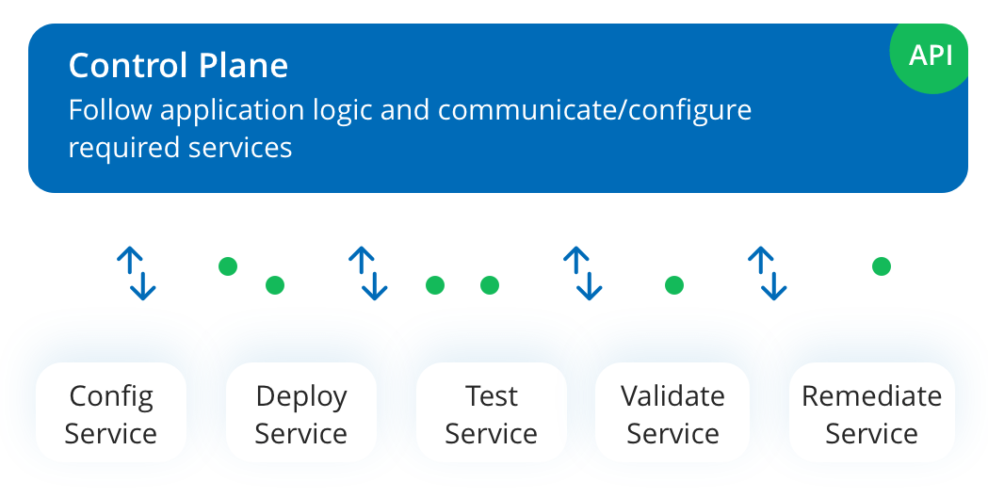




Separation of concern
Cloud Events

Slide 11
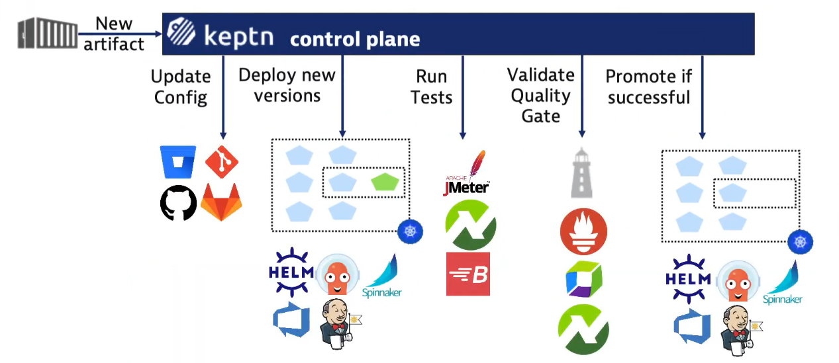
Tools orchestration
keptn works with your existing tools and orchestrates them

Slide 12
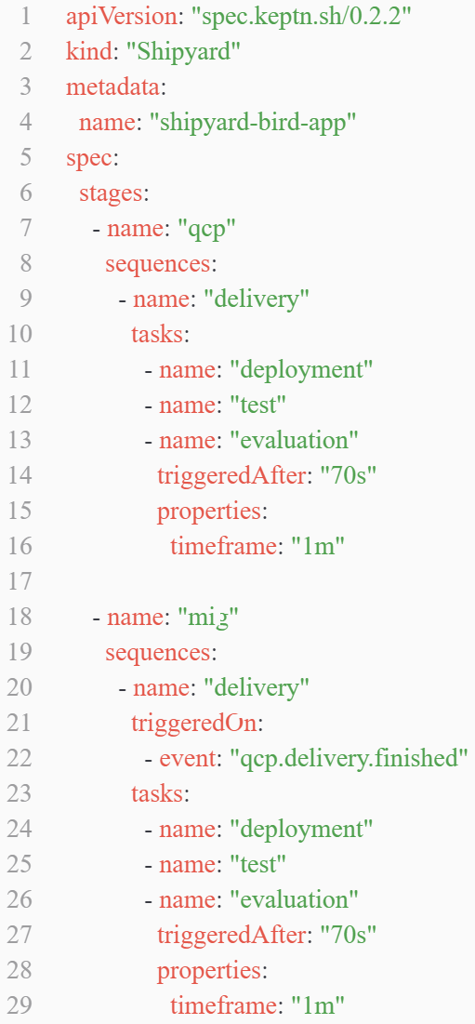
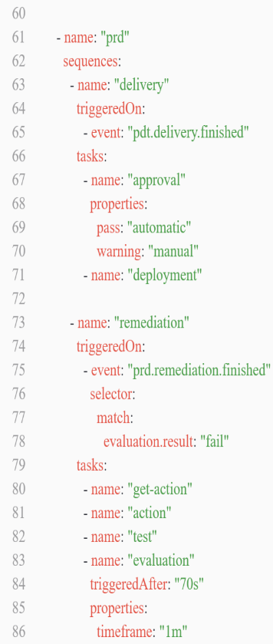
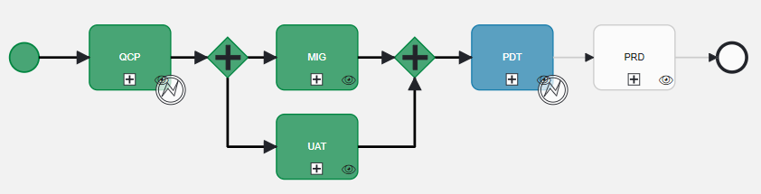

If it was for an OBE?
The shipyard file
Define the workflow for the entire project.
In Amadeus Bird
OBE : Open Backend

Slide 13
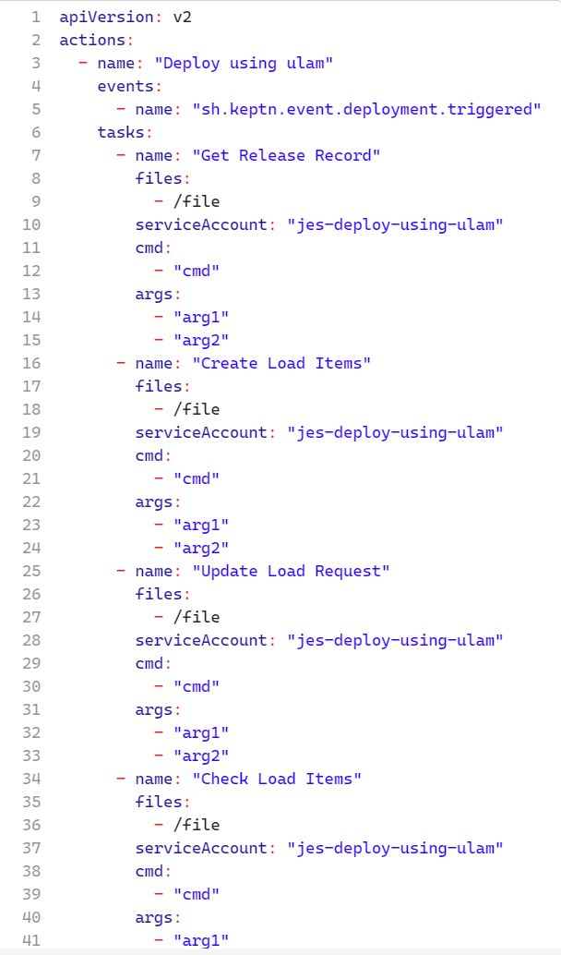
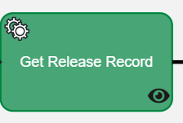
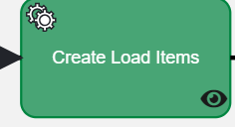
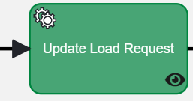
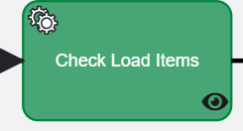
If it was for an OBE?
Workflow
Here the different service tasks are defined in a
configuration file separated from the
workflow configuration file.
+ Less coupling
+ Reusability

Slide 14
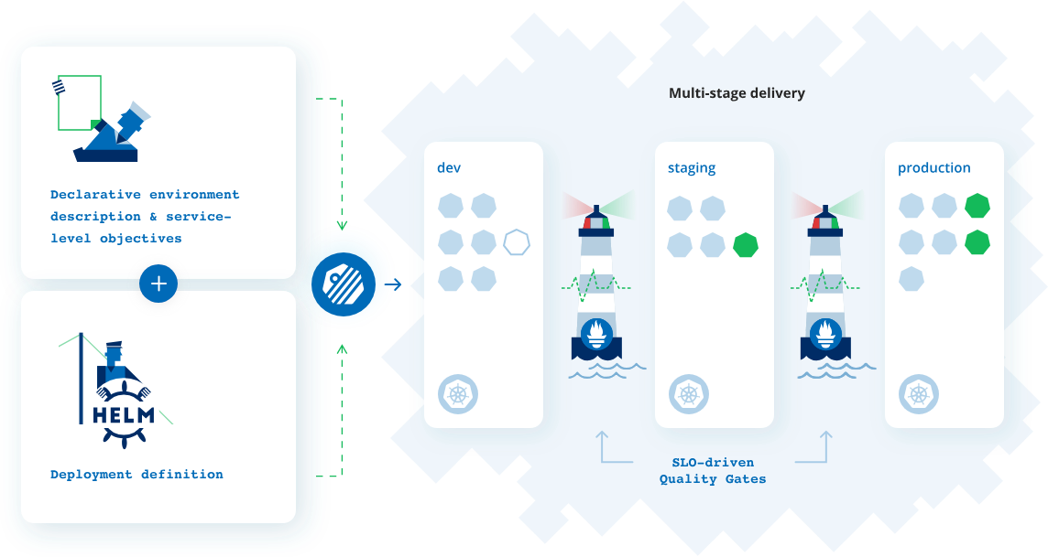
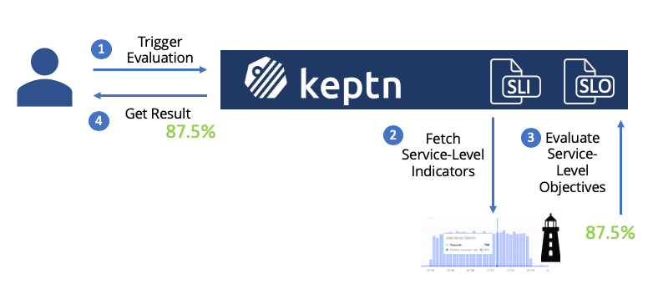
Quality gates Evaluations
SLIs : Service Level Indicators
Defined quantitative measure
SLOs : Service Level Objectives
Target value or range of values

Slide 15
Demo of Keptn

Slide 16
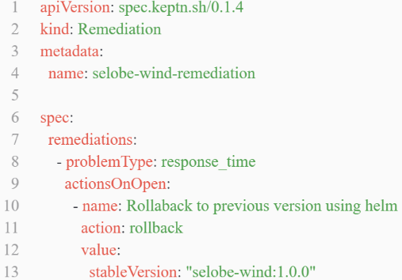
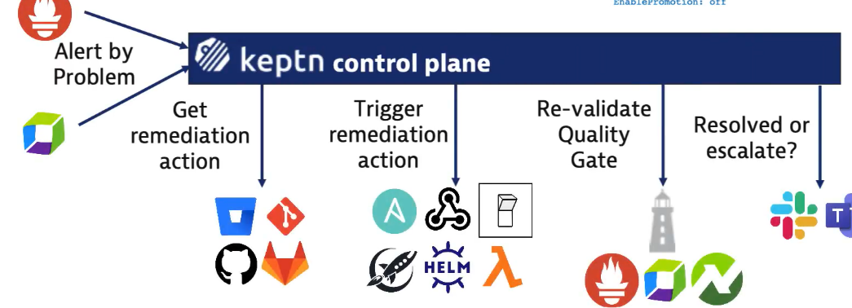


A word on Auto-remediation
With Keptn
v2 deployed
in prod
Upgrade to newer version
Stable v1 release
Rollback to v1

Slide 17
Demo of Keptn : Auto-remediation

Slide 18
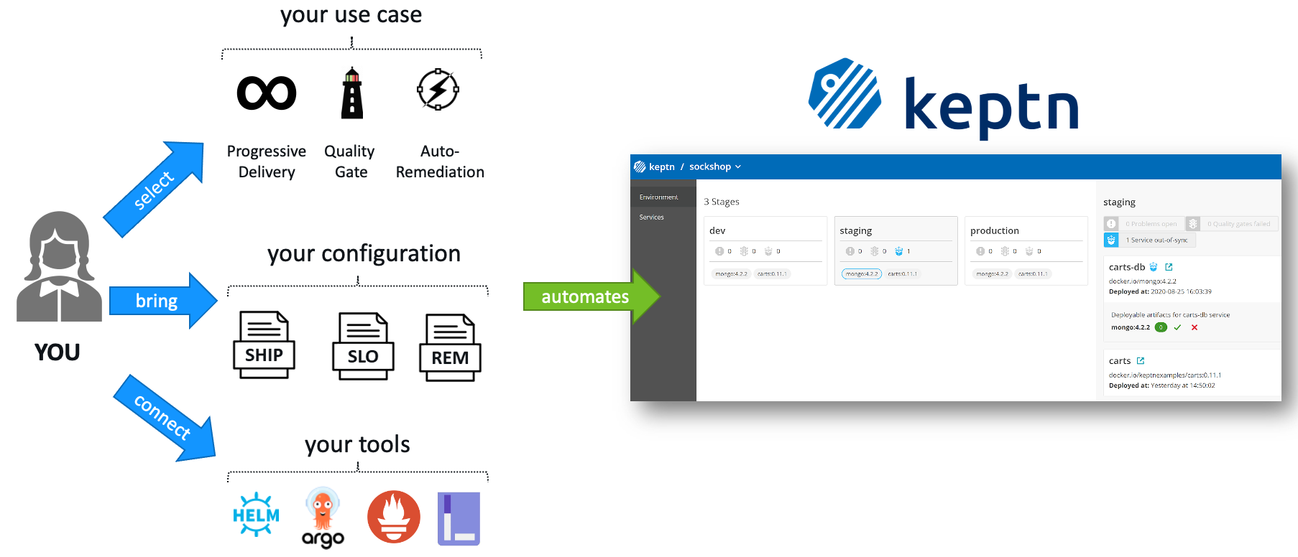
In a nutshell, with Keptn …
Notes:
Tools : keptn works with your existing tools and orchestrates them

Slide 19




2. OBJECTIVES
Technology Watch
II. Contribute to the open-source✨
Notes:
Stay in touch with the state of the art of Continuous Delivery
Evaluate Keptn : purpose, strengths, weaknesses
Useful ideas for Bird or continuous delivery in Amadeus
Make Amadeus an actor of the open-source world ✨
- Contribute to the open-source code of Keptn by writing a Keptn SLI-provider for Splunk

Slide 20






3. Splunk-service & Open-source Contribution
Our integration
We worked on :
Lighthouse service
And now
…
Splunk>
Tool X
Dynatrace
Prometheus
Quality Gates
Notes:
The development of a new Keptn-service (an SLI-provider) for Splunk.
Keptn-service : A Keptn-service is the unit that is executing a task. It can be responsible for executing one or many tasks and it is triggered by an event of a task.
SLI-provider : An SLI-provider is an implementation of a Keptn-service with a dedicated purpose. This type of service is responsible for querying an external data source for SLIs that Keptn then evaluates with SLOs. To configure a query for an indicator, Keptn provides the concept of an SLI configuration.

Slide 21






3. Splunk-service & Open-source Contribution
Technology used
We worked with :
Notes:
The development of a new Keptn-service (an SLI-provider) for Splunk.
Keptn-service : A Keptn-service is the unit that is executing a task. It can be responsible for executing one or many tasks and it is triggered by an event of a task.
SLI-provider : An SLI-provider is an implementation of a Keptn-service with a dedicated purpose. This type of service is responsible for querying an external data source for SLIs that Keptn then evaluates with SLOs. To configure a query for an indicator, Keptn provides the concept of an SLI configuration.

Slide 22





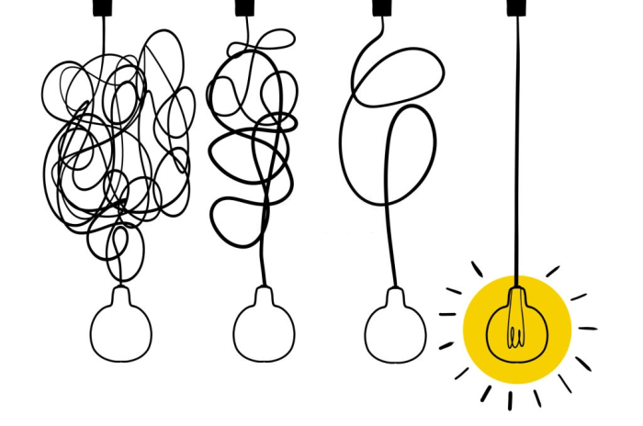

3. Splunk-service & Open-source Contribution
A complete Splunk Service in GO
Quality Gates
Configure.monitoring.triggered event
Configure.monitoring.triggered event
getSLI.triggered event
getSLI.triggered event
Lighthouse service
Splunk Service
Splunk>
Notes:
Subscribes to two (2) keptn cloud events :
configure-monitoring.triggered events
get-sli.triggered events
Handles the get-sli event in order to evaluate the application
Handles the configure monitoring event by setting up the alerts
Polls for triggered alerts in Splunk in order to start the remediation process in keptn

Slide 23
3. Splunk-service & Open-source Contribution
Get-SLI from Splunk

Slide 24
3. Splunk-service & Open-source Contribution
Remediation

Slide 25


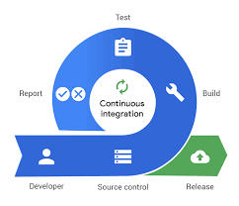

3. Splunk-service & Open-source Contribution
Difficulties
Notes:
SECURITE
des éléments sensibles comme les api token, api url
Polling au lieu d’un webhook

Slide 26

3. Splunk-service & Open-source Contribution
Steps to the contribution
Reviewed by Michele CACI
Asked a Go reviewer : DevOps community
Ip Board validation
IP Board Presentation
Coded
Notes:
Coded in GO
Presented during the IP Board review
Validated for a contribution on behalf of Amadeus
Asked a Go reviewer : DevOps community
Reviewed by Michele CACI, a Go expert in Amadeus
Uploaded in a public GitHub repository in the Amadeus GitHub organization
Created an issue in keptn contribution repo to inform keptn about the repo
Will transfer the project to keptn-sandbox organization
Will present the service in a Keptn Community meeting to have the splunk-service listed on Keptn.sh

Slide 27
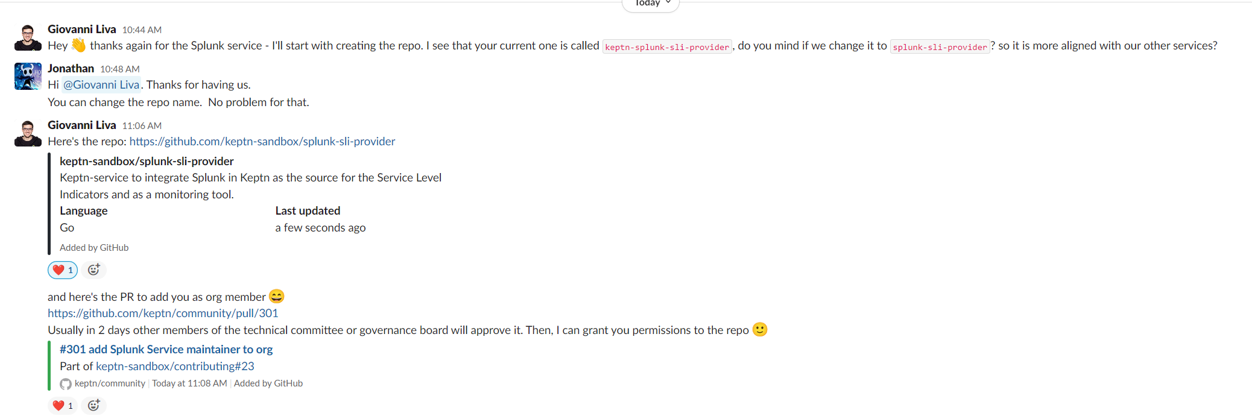
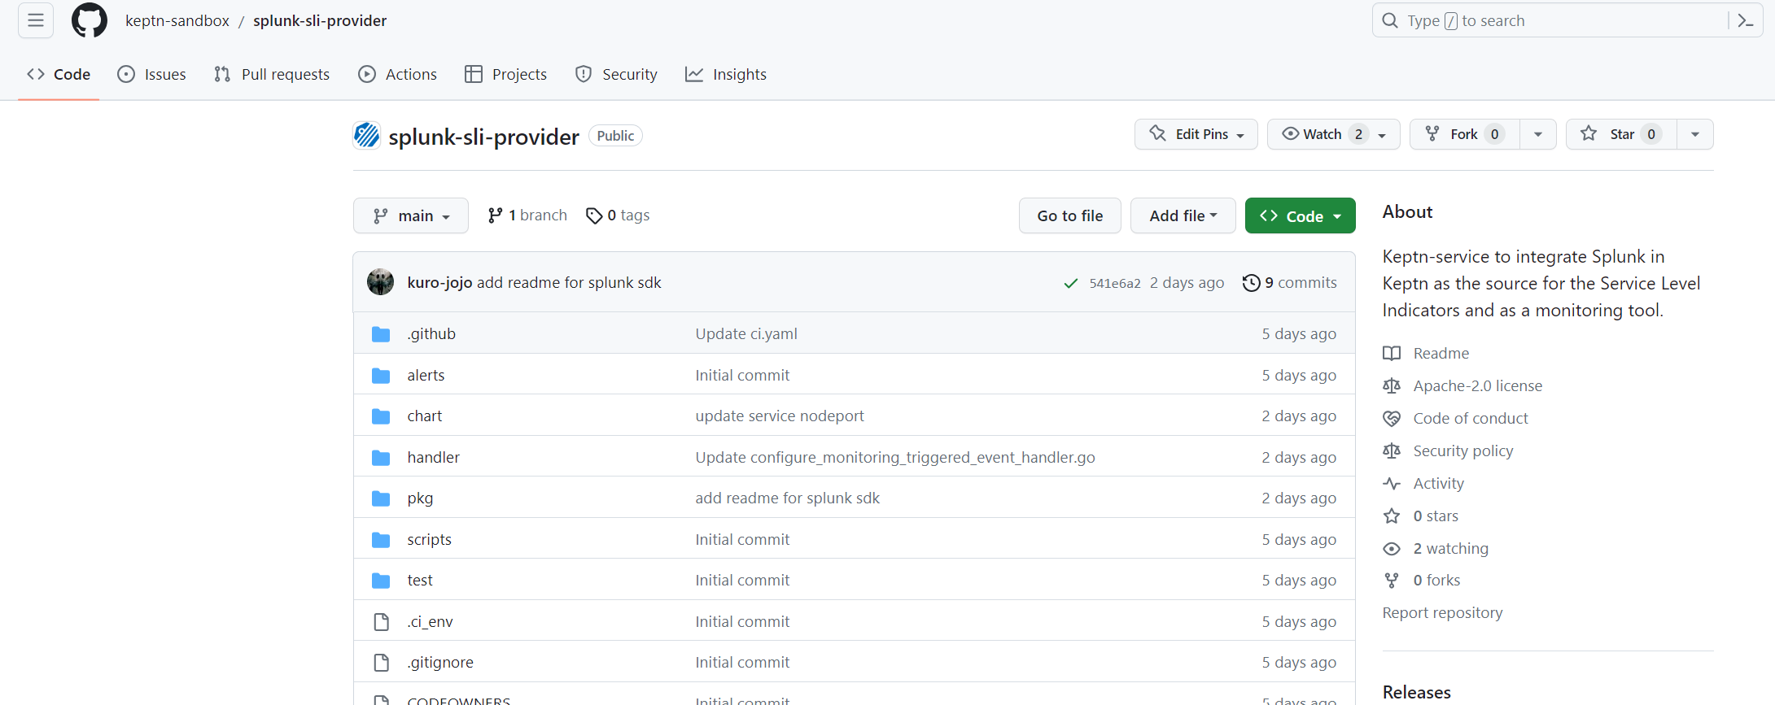
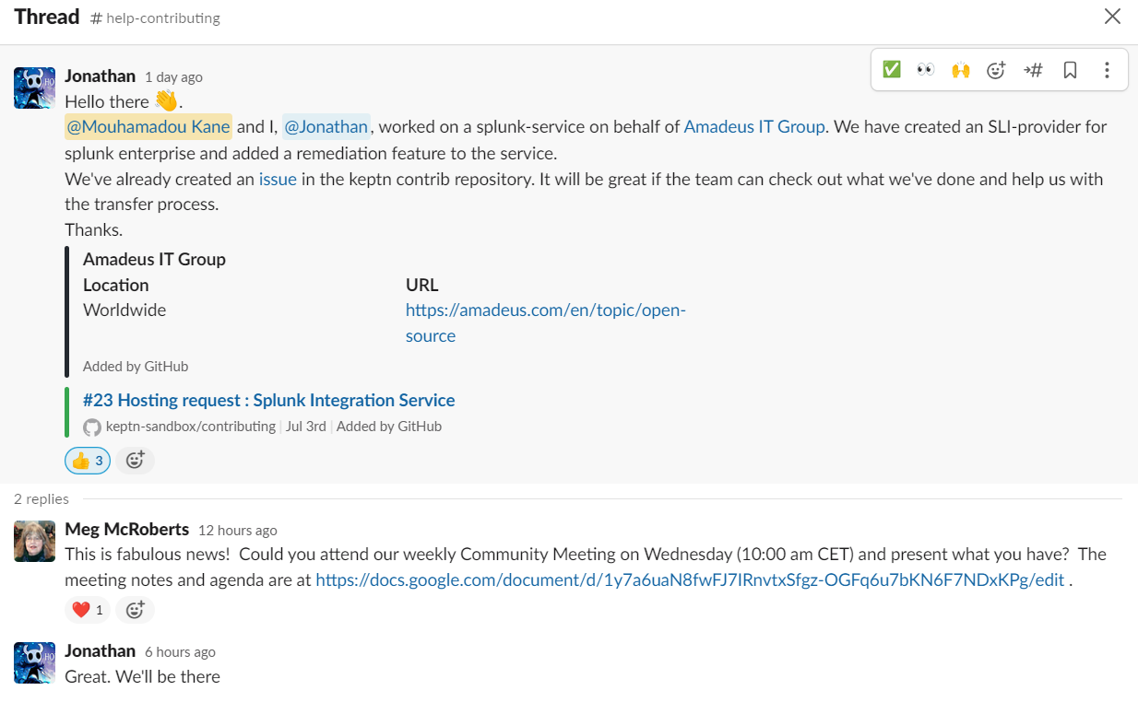
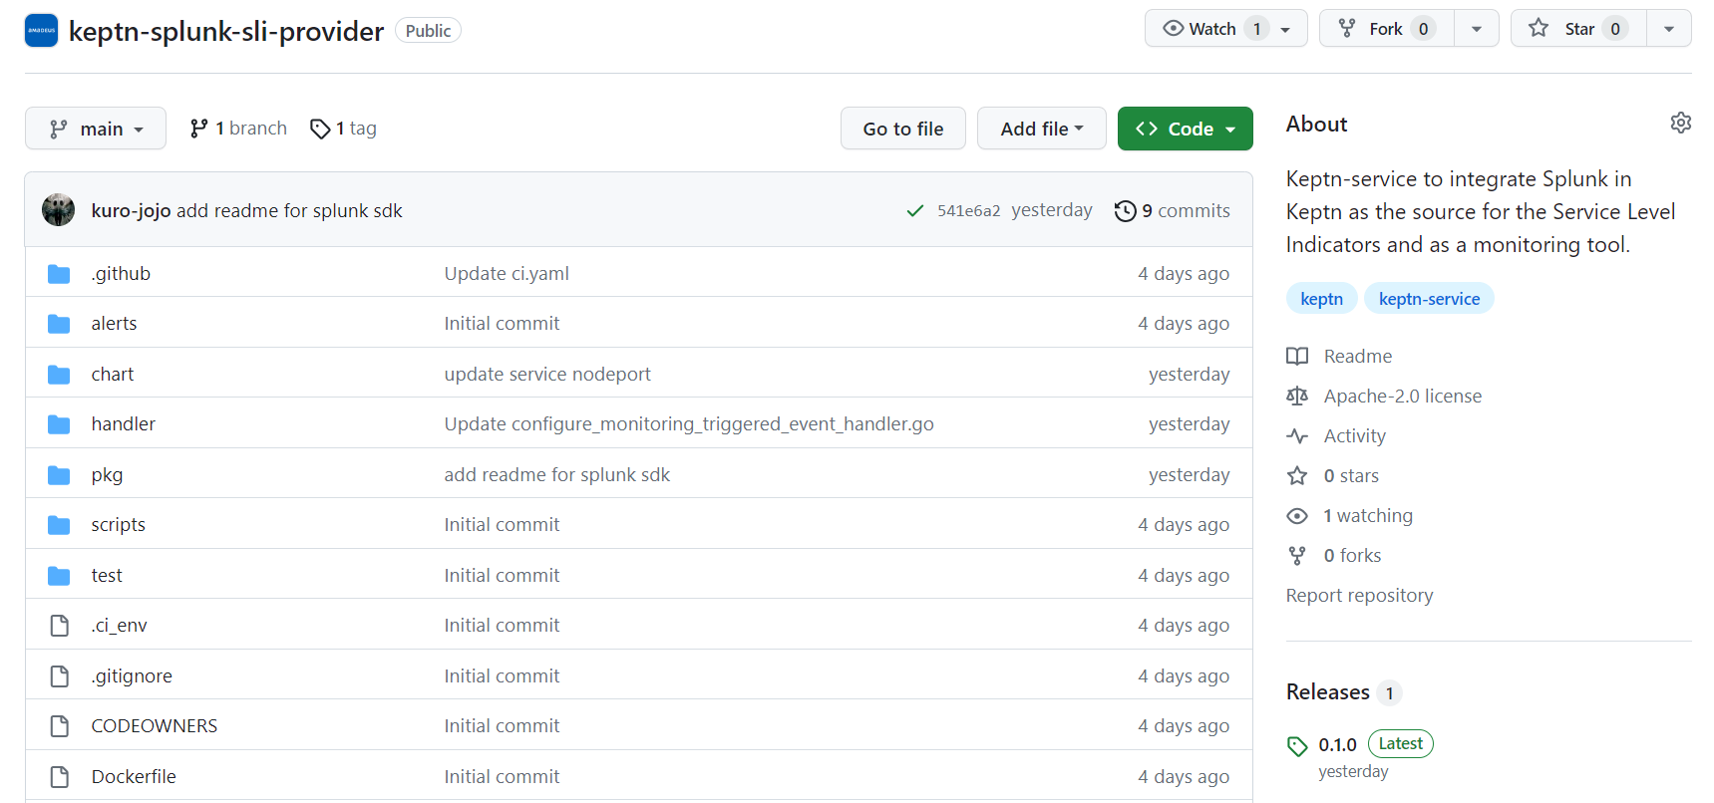
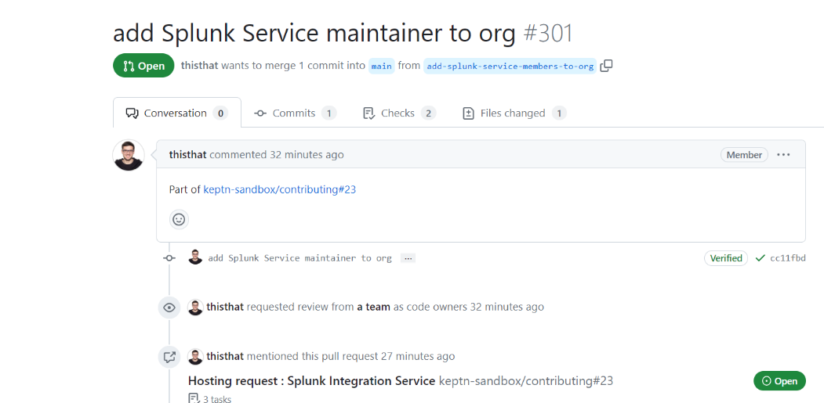
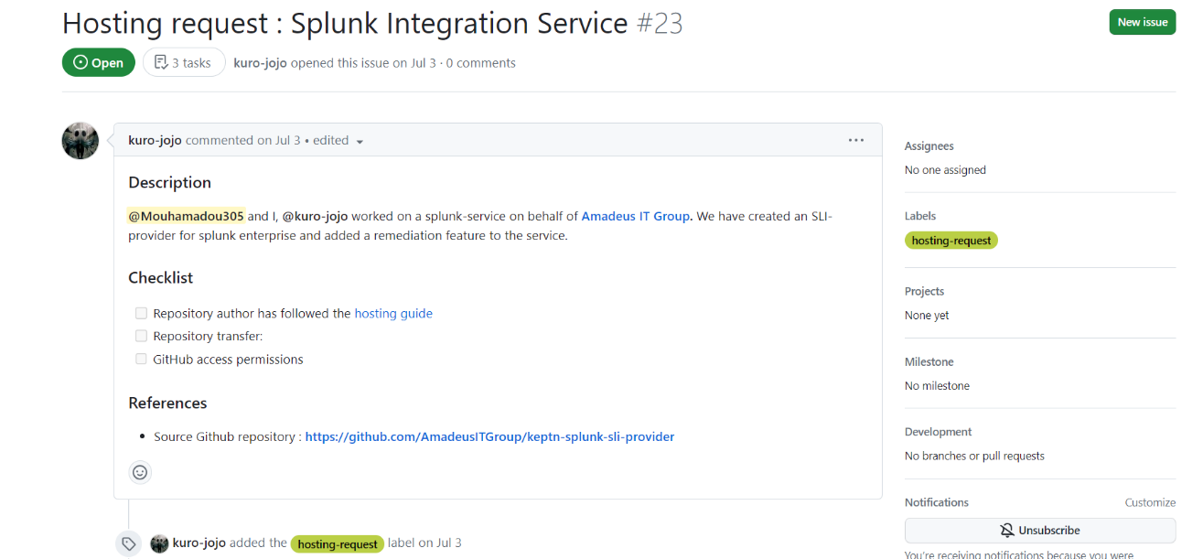
3. Splunk-service & Open-source Contribution
Process in images
Notes:
Loose Coupling / Decoupling of Producers and Consumers
In event-driven architecture, producers and consumers of events are decoupled. That is, the producer of the event does not need to know who the consumer is, and the consumer need not know who the producer is. Since events are processed asynchronously as they occur and there is no dependency on other services, the response times are much higher. There is no blocking on waiting for responses as with synchronous calls.
The independent and autonomous nature of decoupled producers and consumers also reduces the risk of changing one without necessitating a change to others. This gives greater flexibility and agility to bring new functionality faster to the market. It also makes the architecture highly scalable and extensible
Fault Tolerance
Decoupled services also means if one service fails, it does not cause others to fail. The event broker, a key component of event-driven architecture, is a stateful intermediary that acts as a buffer, storing events and delivering them when the service comes back online. Because of this, service instances can be quickly added to scale because it doesn’t result in downtime for the whole system — thus, availability and scalability are improved.
Fan Out and Less Technical Debt
Event-driven architecture is push-based, so if multiple downstream systems need to act based on the occurrence of the event, then the event can be fanned out to these systems in parallel without the need for custom code. This also saves the downstream systems from continuous polling to check for an event occurrence, resulting in less resource utilization in terms of network bandwidth, CPU, etc.

Slide 28

3. Splunk-service & Open-source Contribution
Steps to the contribution
Uploaded to AmadeusIT repo
Created an issue to inform the keptn community
Reviewed by Michele CACI
Asked a Go reviewer : DevOps community
Presented the project to the keptn community
Ip Board validation
Transferred the project to keptn Organization
IP Board Presentation
The Splunk-service is now listed on Keptn.sh, the official website
Coded
Notes:
Coded in GO
Presented during the IP Board review
Validated for a contribution on behalf of Amadeus
Asked a Go reviewer : DevOps community
Reviewed by Michele CACI, a Go expert in Amadeus
Uploaded in a public GitHub repository in the Amadeus GitHub organization
Created an issue in keptn contribution repo to inform keptn about the repo
Will transfer the project to keptn-sandbox organization
Will present the service in a Keptn Community meeting to have the splunk-service listed on Keptn.sh

Slide 29
Thanks !!

